Slide 1
Gherkin and SpecFlow
Automating Specifications for Quality

Slide 2
What is Gherkin?
Feature: Addition
In order to avoid silly mistakes
As a math idiot
I want to be told the sum of two numbers
Scenario: Add two numbers
Given I have entered 50 into the calculator
And I have entered 70 into the calculator
When I request addition
Then the result should be 120

Slide 3
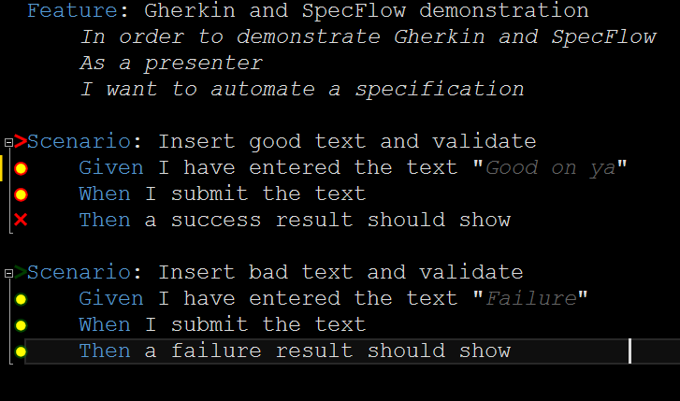
Why is Gherkin worthwhile?
Notes:
It is a living specification because you attach tests.
As requirements change, the specification breaks until the system matches the specification.

Slide 4
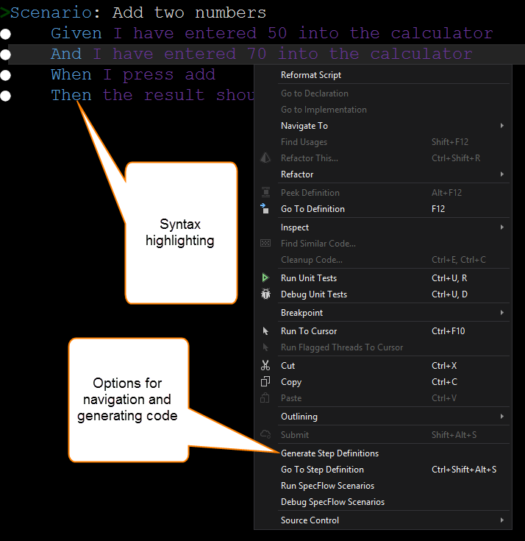
How does SpecFlow tie In?
SpecFlow is a Visual Studio extension that makes writing Gherkin and the accompanying tests easier.

Slide 5
What does the construction of tests look like?
Let’s take a look at an example in Visual Studio.
The test automation will be performed by a tool called Selenium which is used to automate browser actions.
Other tools may be used including direct API automation using tools like .Net HttpClient.

Slide 6
Suggestions: Behaviors
Describe behaviors, not UI controls and user clicks
Controls change more often than application behaviors

Slide 7
Suggestions: Testing API
Create a testing API.
Use it to set up common test scenarios in a consistent way.
This may take as much time as writing the production code, but it will save you a hundred times that in maintenance costs and defect fixes as the product matures and changes.

Slide 8
Suggestions: Start Simple
It is better to have less tests that run with every build than have a thousand tests that rot because nobody runs them.
Focus on the code that runs most often. Don’t try to do everything at once.

Slide 9
Suggestions: Page Objects
If automating UI through Gherkin, use separate Page Objects to house your automation code. Keep the automation code out of your SpecFlow steps.

Slide 10
Suggestions: Reuse
Don’t try to reuse SpecFlow steps. Instead rely on your testing API to be reusable.
Notes:
SpecFlow and Gherkin are intended to have steps be reusable across Features and Scenarios. This is a design flow because it is fragile. Most features have very specific contexts that are not repeatable across tests. Instead, have your Scenarios reach out to a testing API that has greater granularity because it is designed to have independent reusable methods.

Slide 12
Resources
Github repository with this example code and powerpoint: https://github.com/sstid/GherkinSpecFlowExample
The Cucumber Book: https://pragprog.com/book/hwcuc/the-cucumber-book
Excellent Pluralsight course: http://www.pluralsight.com/courses/automated-acceptance-testing-specflow-gherkin
Notes:
Cucumber is another product similar to SpecFlow – the insights from the book are still relevant

Slide 13
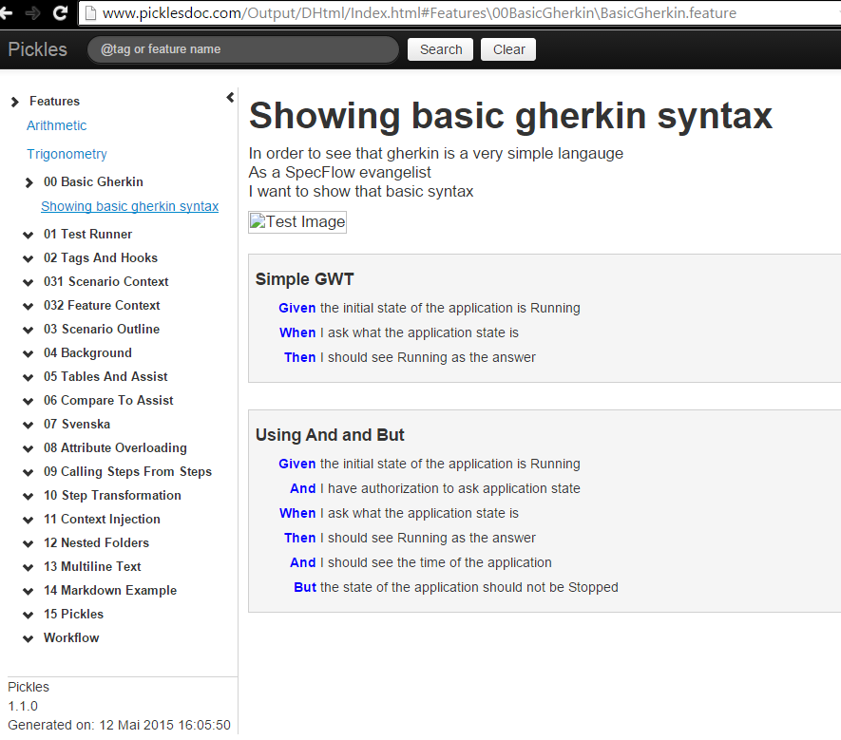
Pickles

